Slide 1

Partner With Us

Slide 2
🔧 Grow Your Business with My Oil Doctor
If your garage provides routine servicing for a wide range of engines — both domestic and commercial — oil sampling isn’t just an add-on; it’s a tool to enhance your business.
The UK market is evolving rapidly, with over 40.4 million cars, vans, trucks, and buses on the road (SMMT, 2020). Meeting the growing demand for smart, preventative maintenance presents both a challenge and an opportunity.
At My Oil Doctor, we make it easy to integrate professional oil, coolant, and fuel analysis into your existing services.
With one simple, all-in-one solution:
🧪 Collect samples using our inclusive kits
📤 Send them to the lab with prepaid return postage
📧 Receive detailed, branded customer reports within 48 hours
It’s fast, reliable, and unlocks significant cost savings for your clients — all while growing your revenue and reputation.

Slide 3
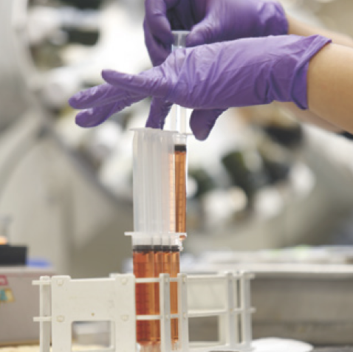
Your Garage & Customers Are In Safe Hands
🌍 Expert Support You Can Rely On
When you partner with My Oil Doctor, you're backed by unmatched expertise through our partnership with Finning, a global leader in fluid analysis.
👷‍♂️ Industry-aligned account managers & diagnosticians
🛠️ Proven application history across 200+ equipment manufacturers
🌐 Access to a global knowledge-sharing network
This means your garage benefits from world-class insight, precise diagnostics, and support that goes far beyond the lab.

Slide 4
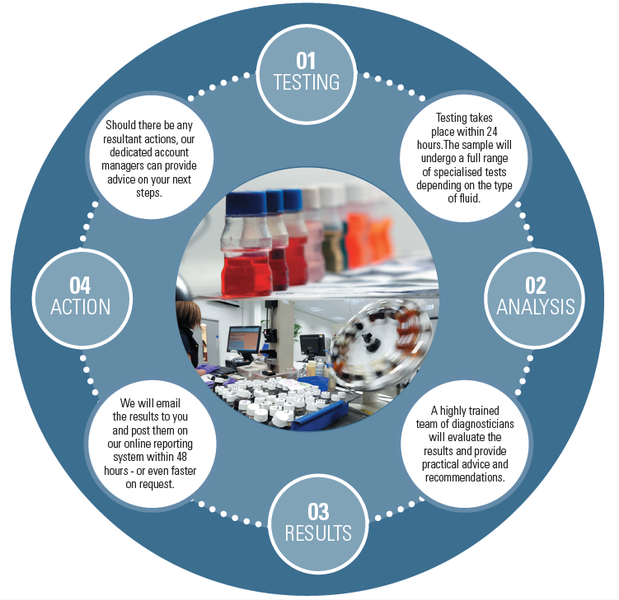
Our all-inclusive test kits are designed for ease, accuracy, and speed. Each kit contains:
🧪 All necessary materials for safe sample collection
📄 Clear instructions for extracting samples easily
✉️ Prepaid 1st Class return mail envelope
🔬 Comprehensive lab analysis covering multiple indicators
⚠️ Severity ratings & maintenance recommendations
📧 Email alerts
📆 Next working day report (from lab sample receipt)

Slide 5
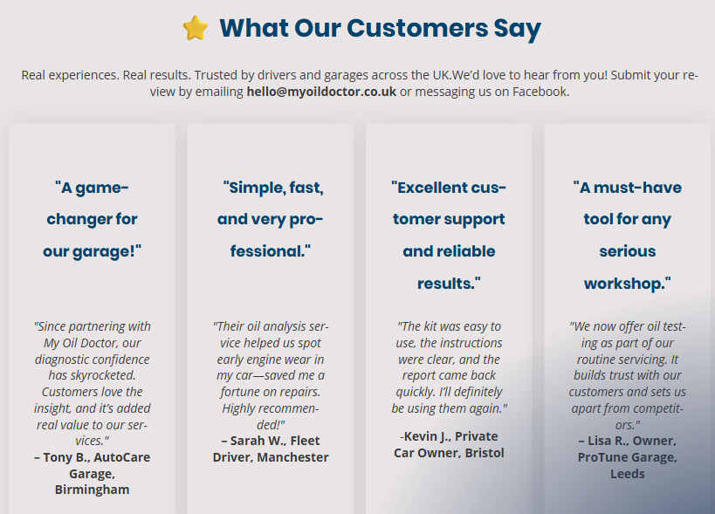
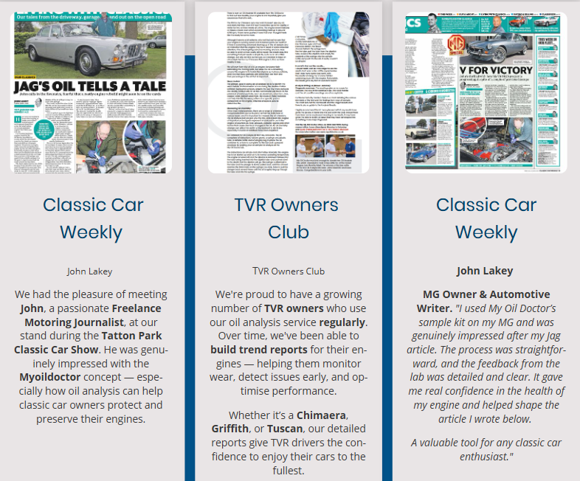
Trusted by Our Customers
At My Oil Doctor, our mission is simple: to offer user-friendly, on-road oil analysis solutions
accessible to everyone. We are driven by integrity, excellence, and continuous improvement, helping our customers streamline their operations and reach their goals with confidence.
By embracing cutting-edge technology and nurturing a culture of creativity and collaboration, we deliver unmatched value and dependable support in every service we provide.

Slide 6

To arrange an online meeting to discuss further
please contact the team direct hello@myoildoctor.co.uk

